Slide 1
App: inventory management
By Umair Rashid (100312938)

Slide 2
Description
An application for the stores to manage their inventory.
The application can help the stores do the following:
Search Inventory By Store
Search Inventory By Product Name
Search Inventory By Product ID
Update Inventory of the store
Change password for store login

Slide 3
Database
The database of this application is divided into Four Tables:
Inventory
Stores
Product
User Info
UserInfo
Username(Store Number)
Password
Inventory:
Product ID
Stores Number
Quantity
Product :
Product ID
Product Description
Price
Weight
Stores
Store ID
Street Number
Street Name
City
Province
Phone Number

Slide 4
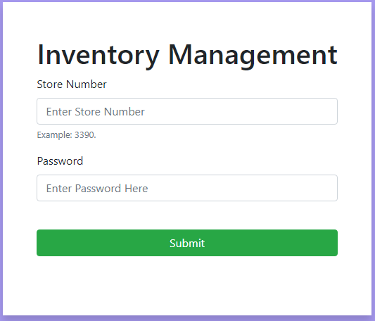
Login Page
Login Page for the Stores
Credentials Needed
Username(4-digit Number) – Store Number
Password
Features
Security
Username validation(Checks if the user entered is between 6601- 6610)
Sign out in the navigation bar will allow users to log out
After signing out the user will not be able to use the application even if they put the correct URL into the browser

Slide 5
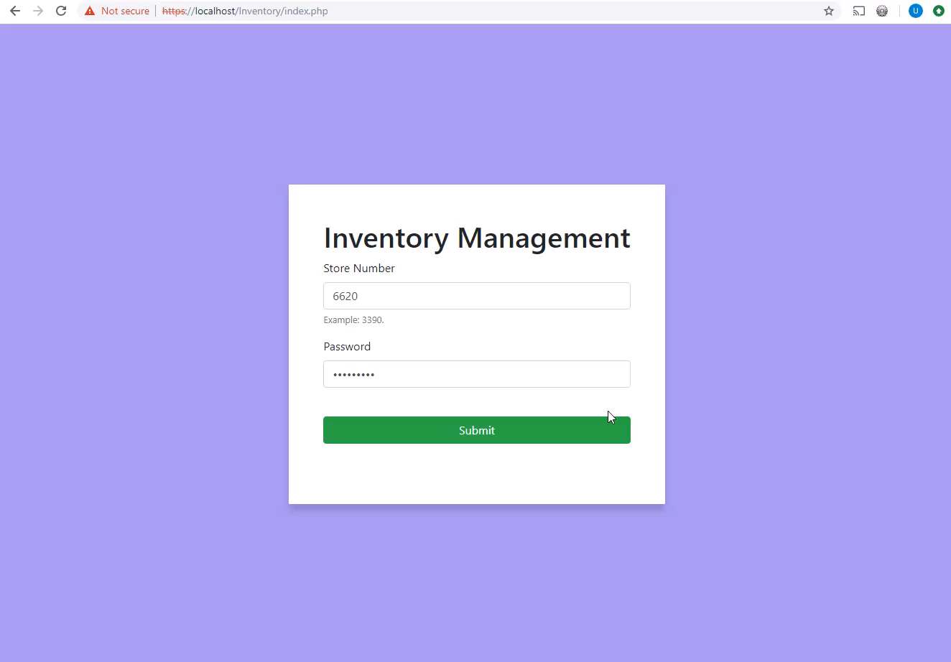
Demo: Login Page

Slide 6
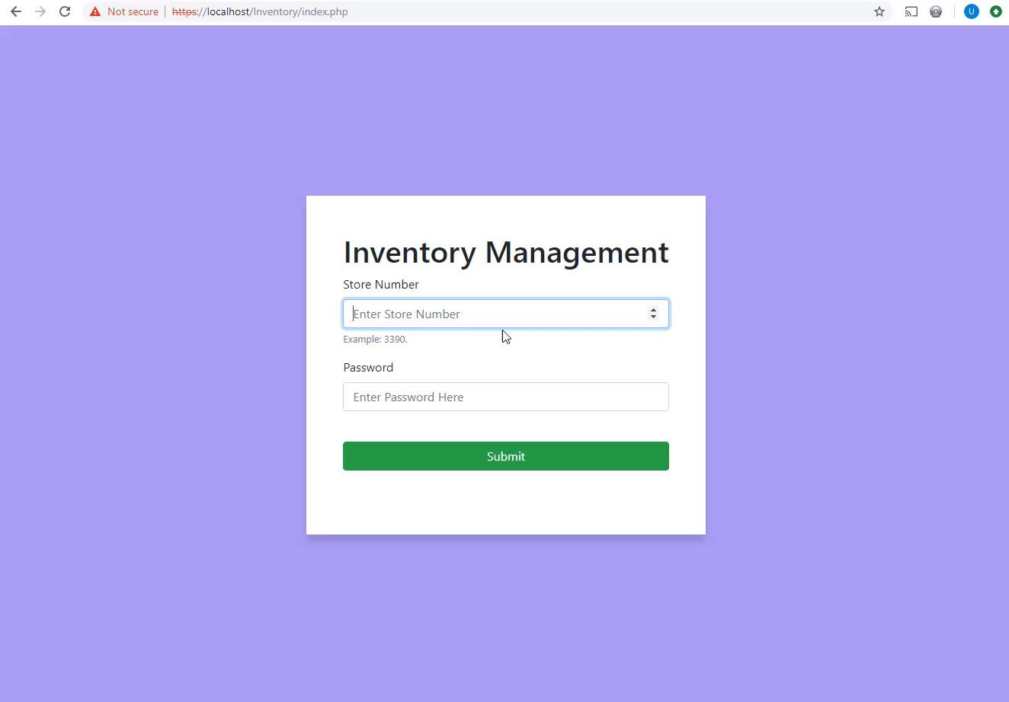
Demo: SIGN OUT DEMO

Slide 7
Navigation BAR
Navigation Bar is fixed at the top of the page.
It displays the store that is currently logged into the application and it can also be used to log out
It has links to the following pages:
Update
Search
Change Password

Slide 8
Search Inventory
This form can be used to search inventory by the following ways:
By Product ID – Displaying all products in different stores with the same product ID
By Product Name – Display all the products by the name
By Store Number – Display all the inventory of the store
Using Datatables to display data.

Slide 9
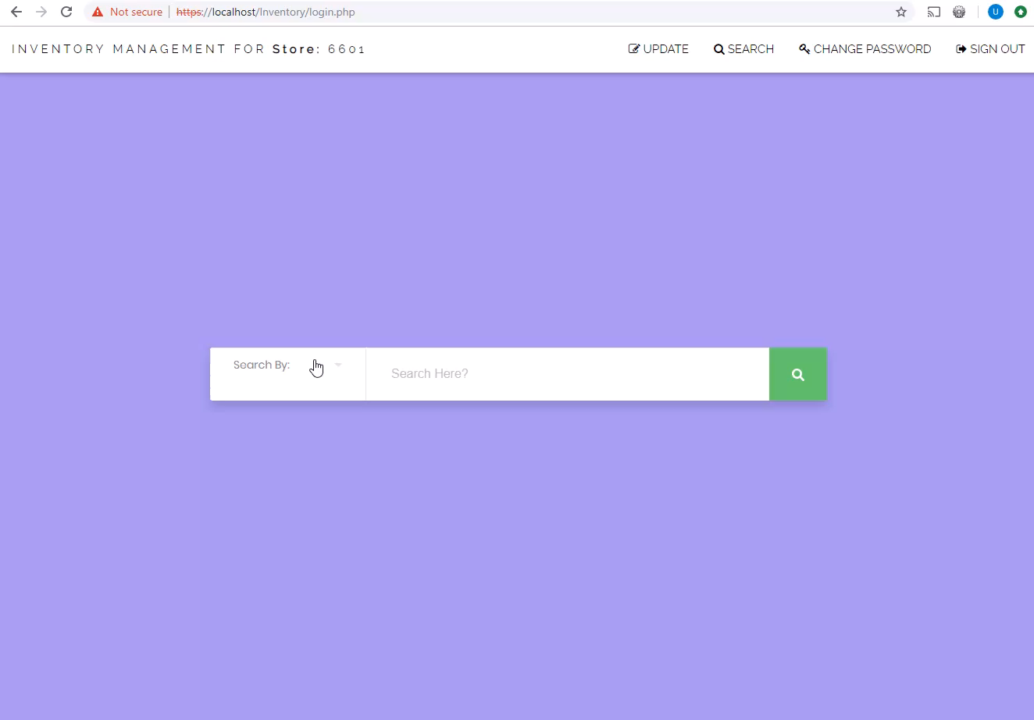
Demo: Search Page

Slide 10
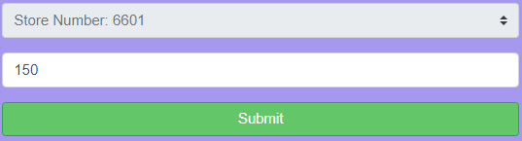
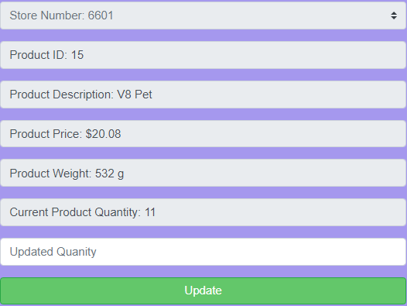
Update Inventory
This page can be used update inventory for the store currently logged in the application
This feature will not allow the user to update other stores
Each store cant have more than 20 item of the same product
Valid product ID is between 1 and 100
A confirmation will be displayed to the user upon successful update

Slide 11
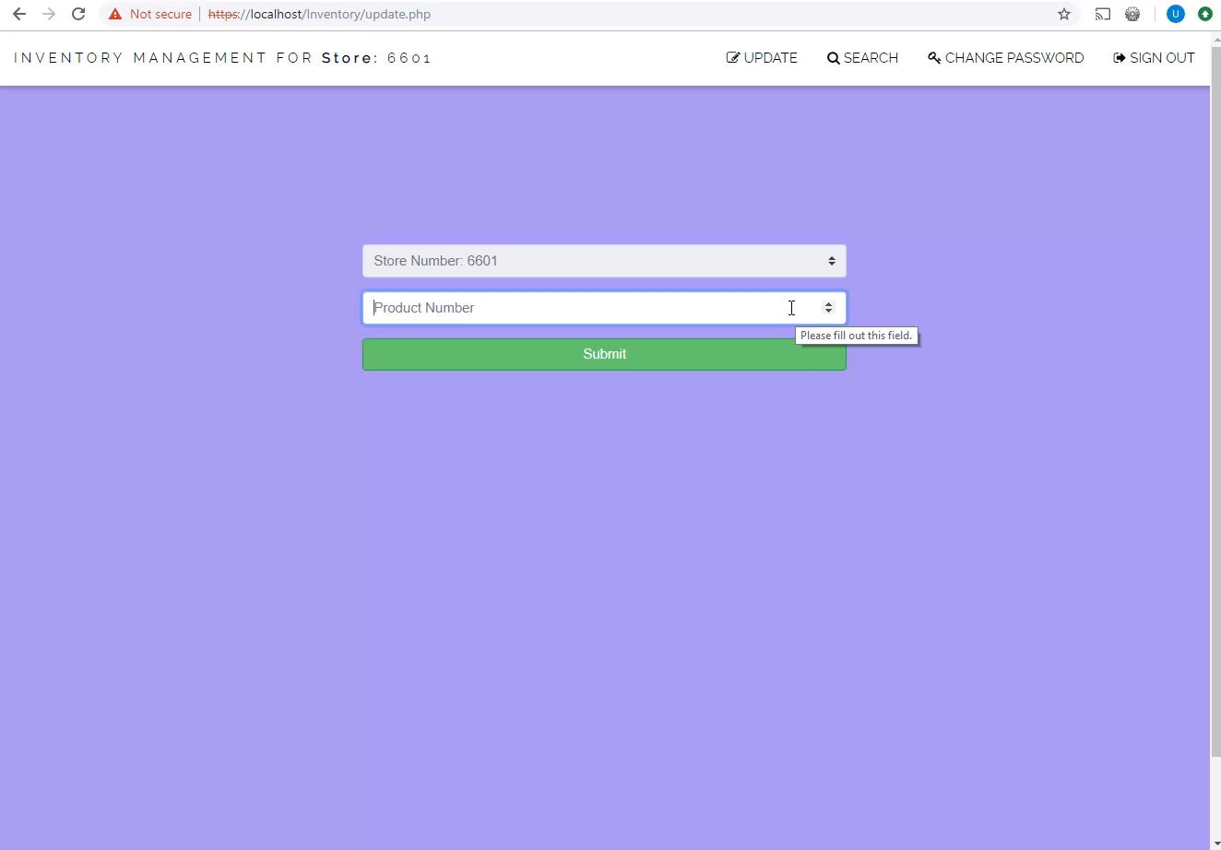
Demo: upDate Page

Slide 12
Change Password
User can change password using this page
User must know the current password
User must enter the valid current password
New password will be entered twice and should be matching.
Changes will take place right away

Slide 13
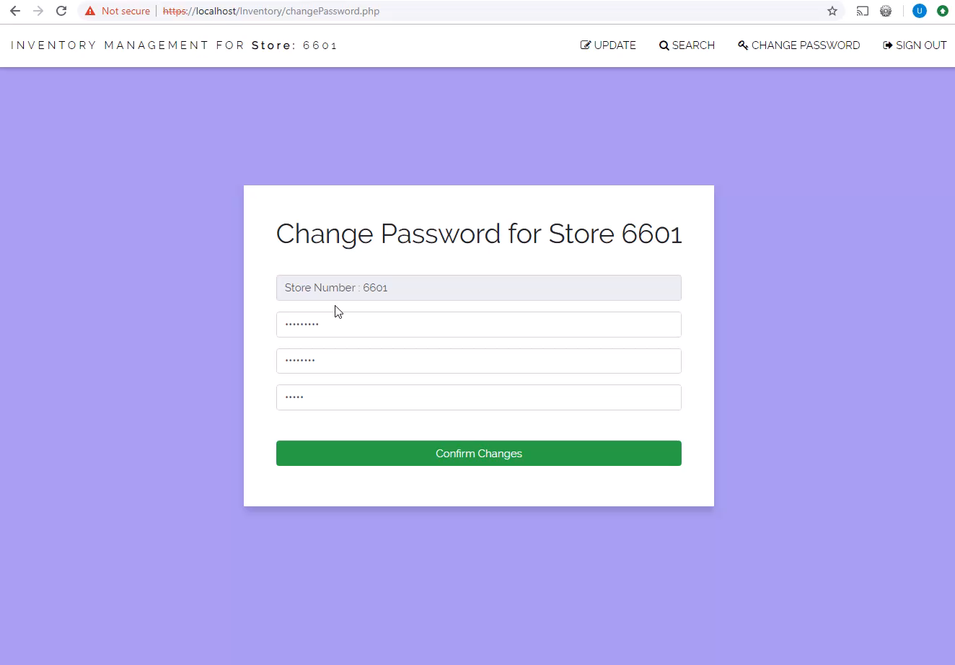
Demo: Password change Page

